Slide 1
Data Management Platform

Slide 2

DMP and Salesforce Krux Overview
A User Journey in Marketing.
Different components of Marketing Cloud.
DMP’s place in Marketing Cloud.
A Glance at DMPs available in Market.
Journey in Marketing Cloud
Looking at a Business use case
Understanding the DMP in Marketing CLoud
Comparing DMP Platforms

Slide 3
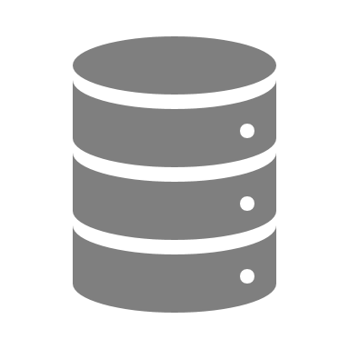





Customer Journey
LEGEND
Marketing USE CASES
DMP USE CASES
SFDC USE CASES
to deliver a seamless, personalized customer experience…
Journey
Acquisition
Onboarding
Retention
Evaluate & Purchase
Post Purchase/ Loyalty
BOUNCE
Steps / Touchpoints
USER INTERACTS WITH THE BRAND DIGITALLY
USER INTERESTS CAPTURED
UPDATES/PROVIDES CONTACT INFO
FIRST POINT OF CONTACT
Site/EMAIL
ACCESSED
CONVERSION
COMPLETE
CROSS-SELL
(ON-SITE)
COMING BACK TO THE WEBSITE
USER INFO STORAGE
USER SENT ON CUSTOMIZED JOURNEY
EMAIL
BOUNCE
Data collection in DMP.
Segments in DMP.
EMAIL OFFER

Slide 4
Data Management Platform
Why DMP ?
Its more than just a database.
What is DMP?
THE ''D'' IN DMP:
What It does?
Creates a new knowledge ecosystem .
Enhanced Display Targeting
Data Aggregation
Multi-Channel Digital Activation
Marketing Database
Unified technology platform that intakes disparate first-, second-, and third-party data sets.
Manages data , generates insights and
Analytical firepower- Custom reporting across all digital media channels.
user experience on their website or apps, and increase brand recognition.
To discover and add new customers online.
Enhances conversion.
Accurate targeting and personalized content.
Acts as an audience hub for other integrated platforms.
Provides actionable insights for current and future campaign planning .
Leverages market vendors via various integration.
Collecting 3rd party and 2nd party data.
Audience and segment creation.

Slide 5
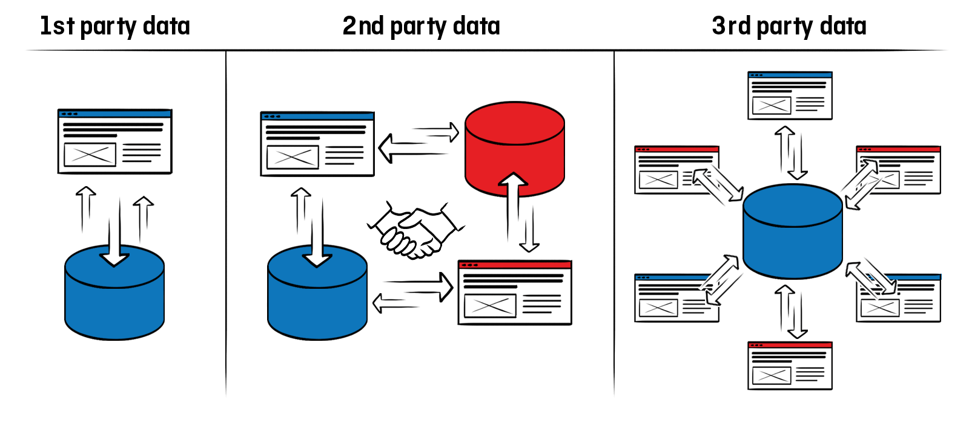
What Types of Data Does a Data-Management Platform Collect?
Web and mobile analytics tools.
Ad-serving data.
Transactional systems.
Subscriptions and newsletter signups.
Audience information.
Icrossing.
Duns and Bradstreet.

Slide 6

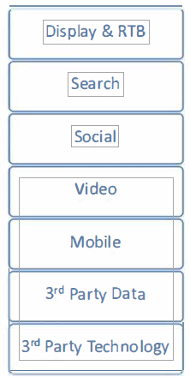

Single Point of Access for Data from different Sources.
1st Party Database

Slide 7
Unparalleled Insight Drives Business Value
Robust user-level data analysis on digital assets driving performance and business value
Maximize unique reach
For a multi domain/sub-domain site, data can be segmented.
For each domain/sub-domain, unique visitors can be identified.
Audience for each domains/sub-domains can be treated as an audience and targeted separately.
Campaigns for a specific sub-domain traffic .
Abc.com
Site 1
Client.com
Referrers
Paid ads
Organic

Slide 8
Unparalleled Insight Drives Business Value
Determine true value of channels
Marketing Channels.
Marketing channel is a way to reach out to the Users online.
It is the most widely used way to enhance business.
Display, SEO, Email, PPC, Social Media Marketing, Content Marketing etc as per B2B / B2C needs.
Display
Search
DMP uses different marketing channel data for understanding the users and types of marketing strategies used.
It helps to analyze the performance of each channel’s data collected under one shed.
DMP enables business to integrate multiple channels easily.
Emails
Pay-per click

Slide 9
Salesforce DMP (Krux).
Brief Info
Capabilities
Krux is the DMP platform included in the Salesforce Marketing Cloud.
Salesforce DMP approaches data management differently from other DMPs.
Empowers marketers to use data to impact every touchpoint along the journey, powered with AI.
It helps to predict the best audiences to reach out to with ads, know when to follow up on campaigns and how to distribute resources between different media types.
Delivers an integrated, intelligent platform to capture, unify, understand, and activate on all consumer touchpoints.
Change management
Segment: creation & management
Data security & leakage prevention
User Interface: flexibility and usability
Agonistic solution that can be plugged with any solution of the market.
Acts like a tag manager through their SuperTag feature.

Slide 10
Salesforce In Today’s market.
Every month, Salesforce DMP:
Interacts with more than 3 billion browsers and devices.
Supports more than 200 billion data collection events
Processes more than 5 billion CRM records.
Orchestrates more than 200 billion personalized consumer experiences.

Slide 11
Salesforce DMP vs Other DMPs.
Salesforce DMP (Krux) | Adobe Audience manager
Krux supports client side as well as server side data forwarding. | Adobe Audience Manager supports Server side forwarding.
Krux ingests raw data and applies machine learning to allow insights to flow. | AAM uses algorithmic approach on aggregated data which sometimes gives inherent biased insights.
Event-based framework to collect custom data. Reduce Redundancy. | AAM doesn’t leverage event based framework, instead rely directly on conditions
Historical data is available for creating any segments. | Historical Data cant be accessed for segmentation.
Krux has a dedicated Tag Management Framework “Super Tag” to leverage inhouse TMS capabilities for DMP Tags. | AAM mostly rely on a TMS which has to be integrated.

Slide 12


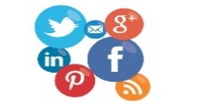




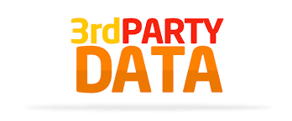
Data Collection Strategy
Web & App
JavaScript Tags / Event Trackers (cookies / S2S)
PAID MEDIA
(SEARCH, DISPLAY, SOCIAL)
Contact &
Customer Data
1st Party Import – Structured Data (file based)
via. Data onboarding provider (cookies)
Media /
Pixel tracking
via. Media tracking (pixel / url)
Destination Mapping (S2S / Cookies / URL)
DMP
Personalization and Targeting.
via. Ad logs (file based)
Email Metrics
via. Email tracking (pixel / url)
Reporting Layer
Data Providers
via. DMP Marketplace (cookies)

Slide 13
APPENDIX

Slide 14
Salesforce DMP
PII & Attributes
Attributes
Data Warehouse
Onboarding Partner
KUID & Attributes
1st Party Imports + Structured Data
Segment Creation, Activation & Management
Look Alike Modeling
Machine Discovered Audience
Campaign Performances
Event Tracking
Journey Insights
Data Governance
Frequency Management
Insights & Reports
1st Party Imports + Structured Data
Partner Management – Send Segments
Partner Management – Send Segments
Activation into DSPs, Ad
Servers, SSps, Search,
Social, Site Side
Personalization System &
Salesforce cloud
Websites
Attribution Collection
Event Collection(conversion
Signups, downloads)
User Matching(1st Party ID,
Partners ID, 3rd Party ID)
JavaScript Tags/Events Trackers/User Match Pixels
JavaScript Tags/Events Trackers/User Match Pixels
Mobile App SDKs or Mobile Logs
Mobile App SDKs or Mobile Logs
API HTTP End Points
API HTTP End Points
All Logs
Structured Data Files
Mobile Apps
Structured Data Files
API Server Calls
3rd party Data
User segments
Segment Mapping
Audience Segment
Media Data
Paid search User Data
Site User Data
http://hart.com
Media Impressions/Clicks
Via JavaScript trackers
External Systems
BI, ESP, Attribution

